Slide 1
Gravitational Waves
Supplement to Lecture XV
October 23, 2019

Slide 2
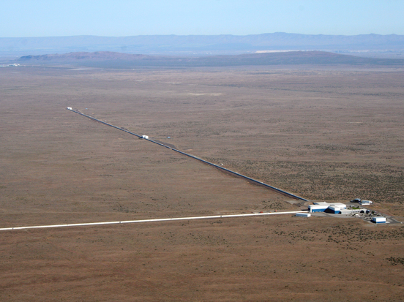
LIGO – Hanford Site (1 of 2)
Caltech / MIT / LIGO Lab

Slide 3
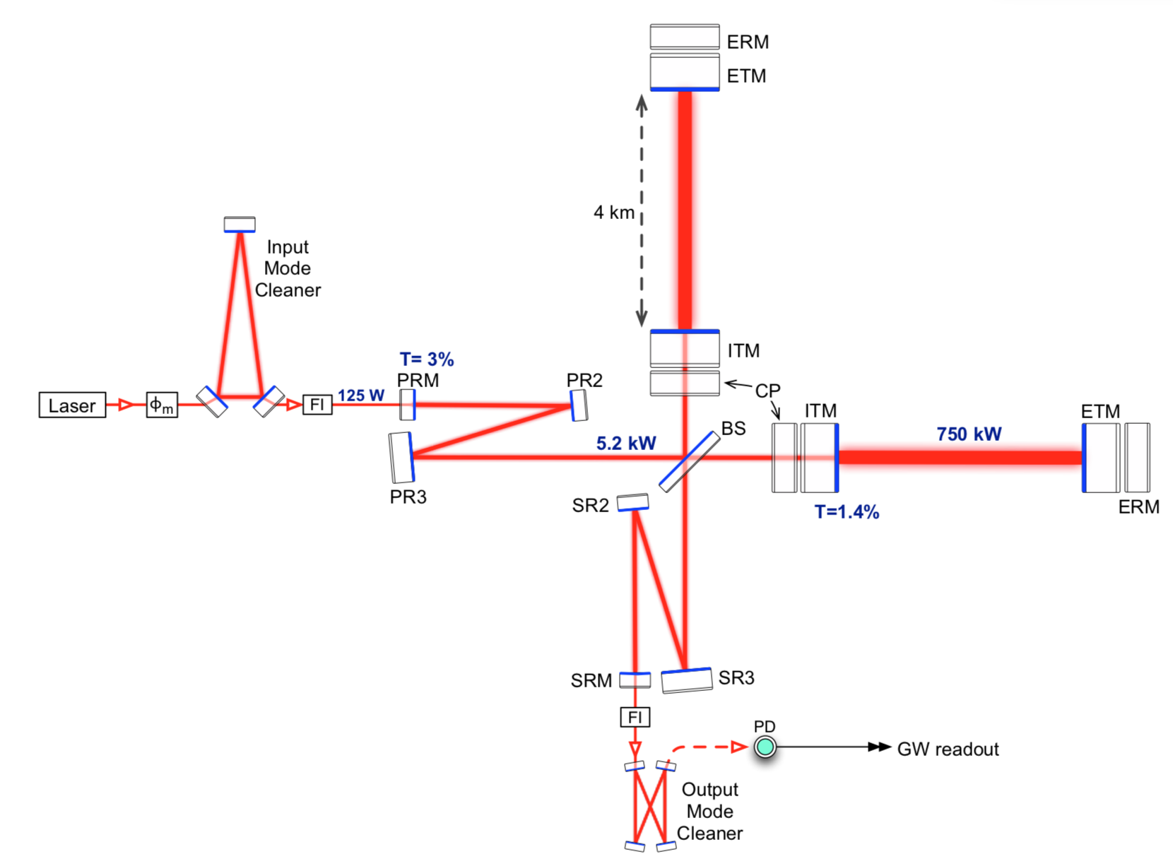
Advanced LIGO
Optical Layout of the Interferometer
[Fabry-Perot Cavity]
LIGO Scientific Collaboration (2014)

Slide 4
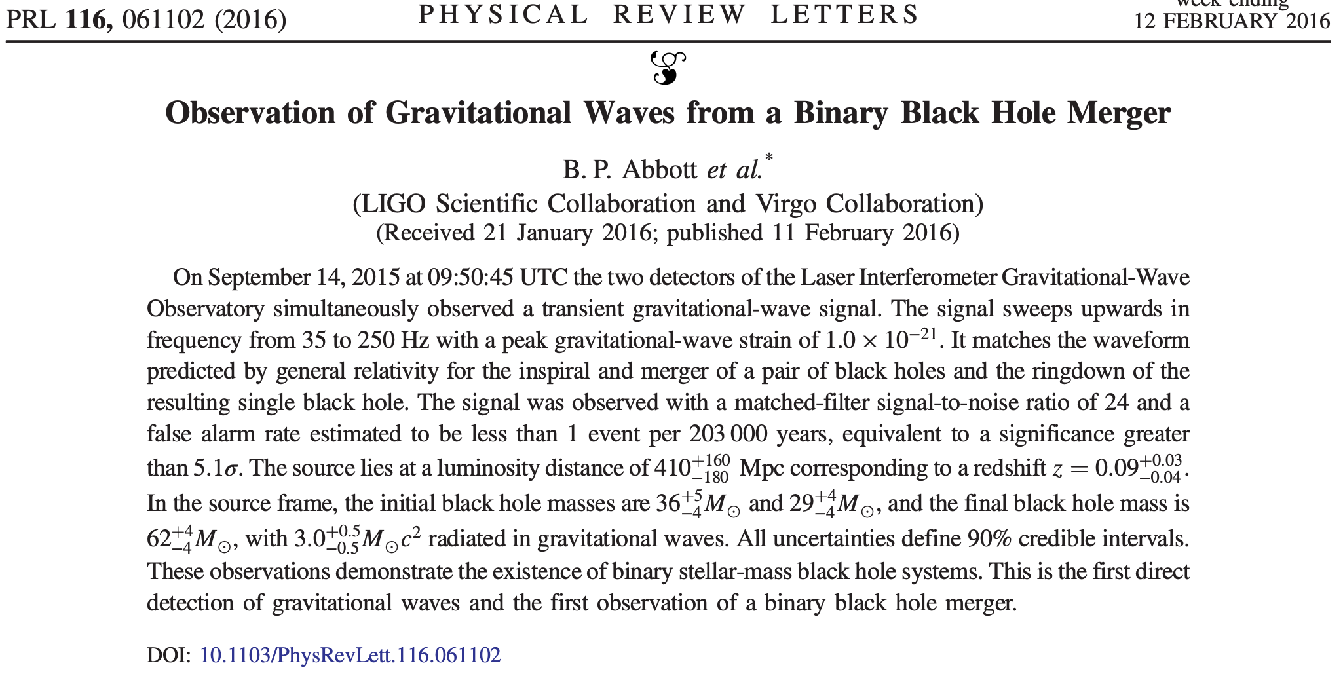

Slide 5
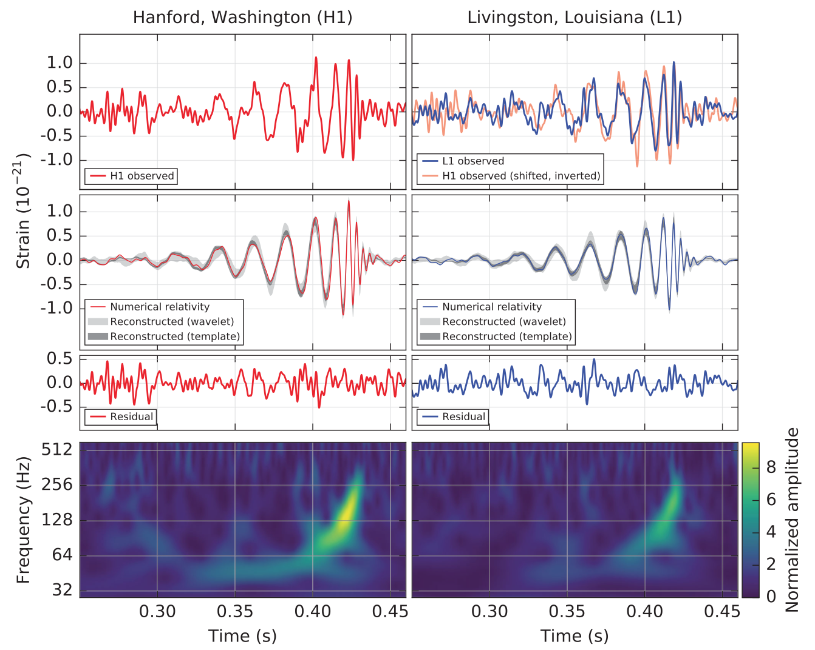

Slide 6
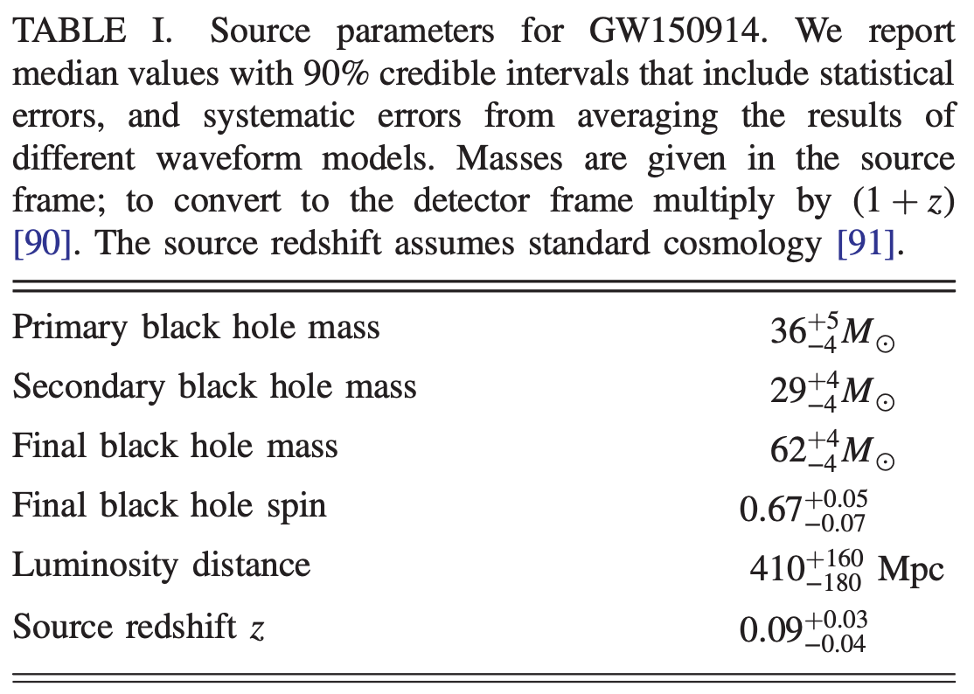
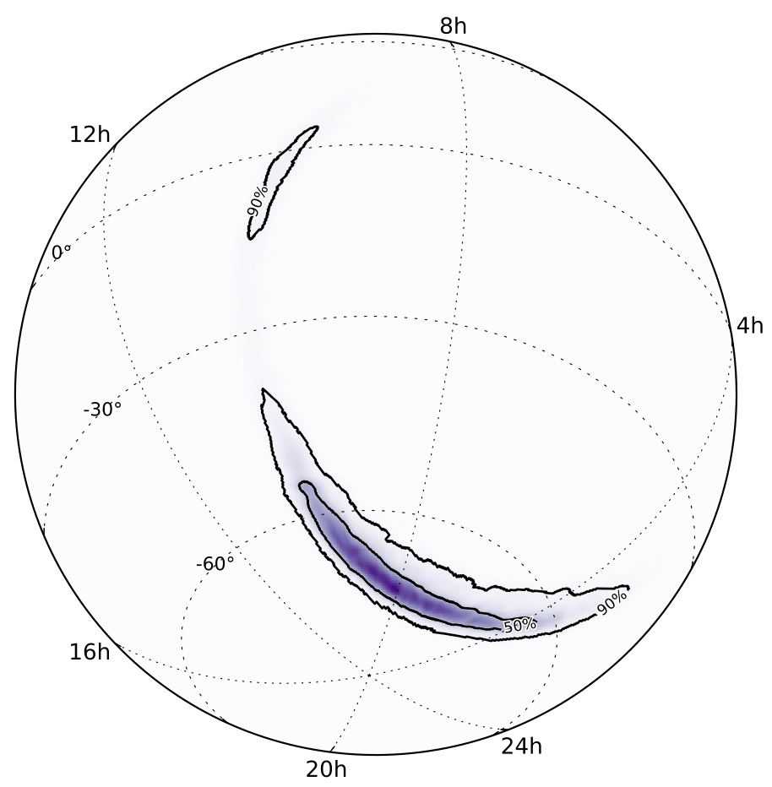
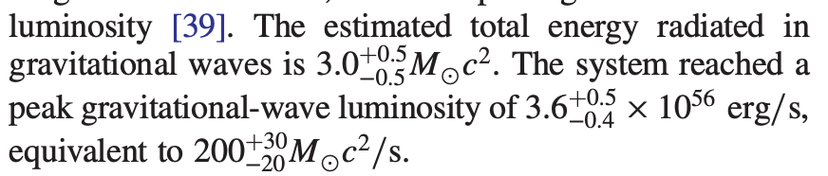

Slide 7
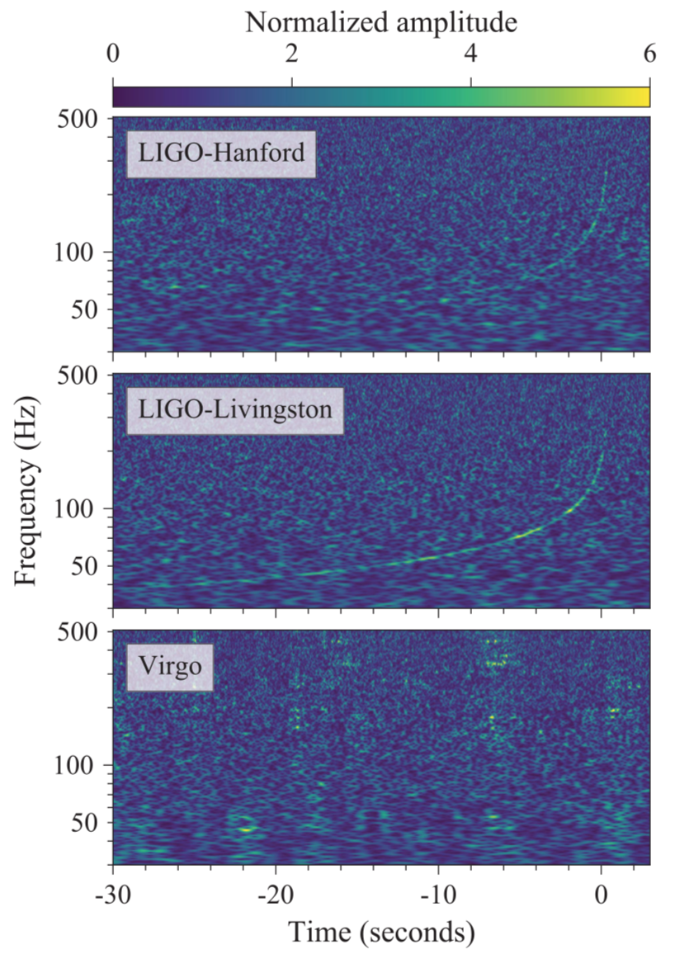
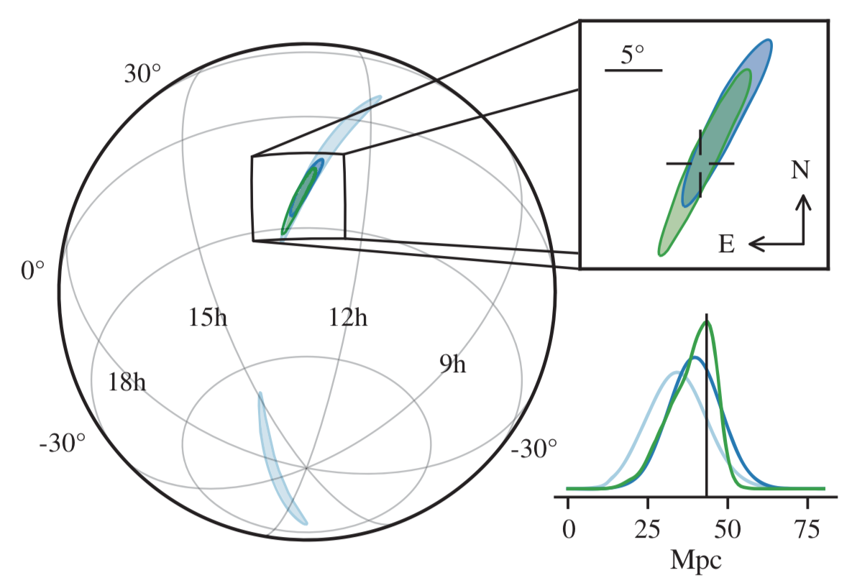
GW 170817 (LIGO + Virgo Collaborations 2017)
Sky localization

Slide 8
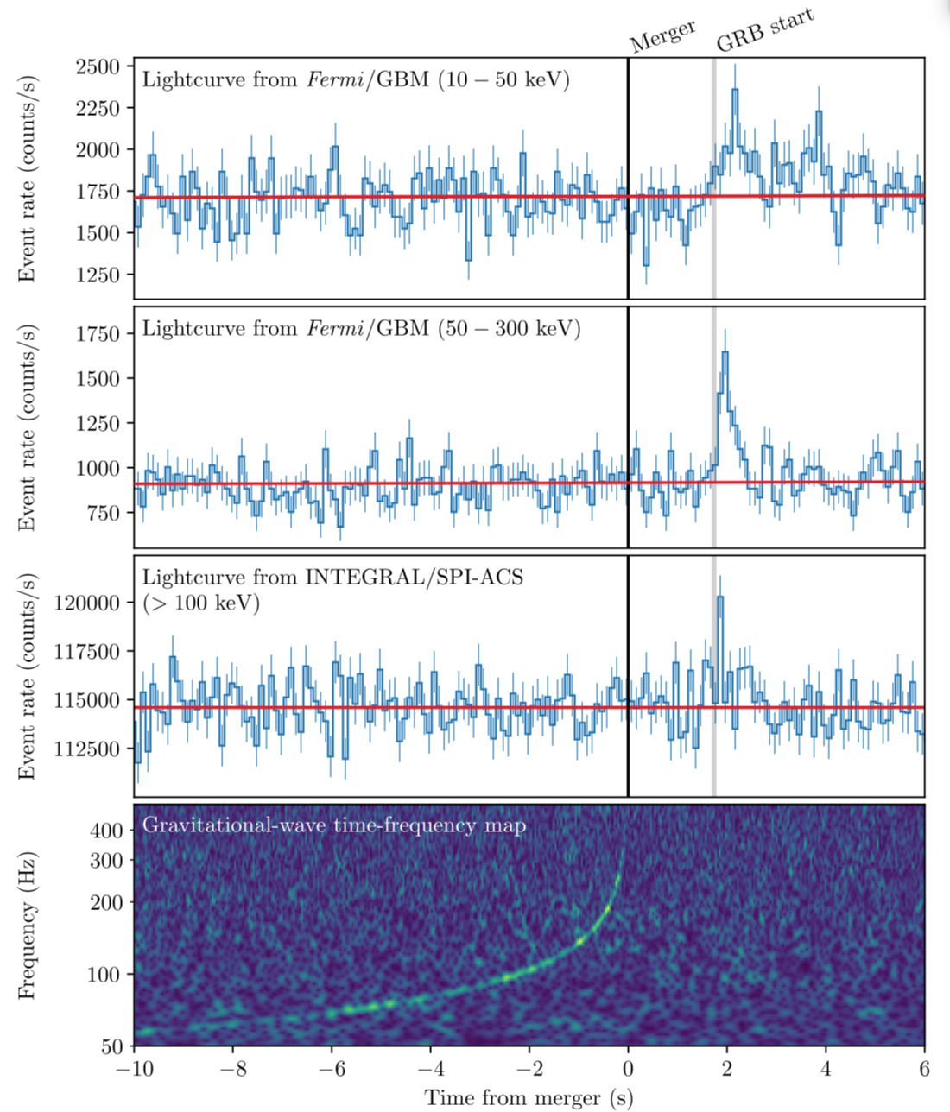
Gamma Ray Burst
Coincident with GW Event
(LIGO, Virgo, Fermi-GBM, INTEGRAL Collaborations, 2017)

Slide 9
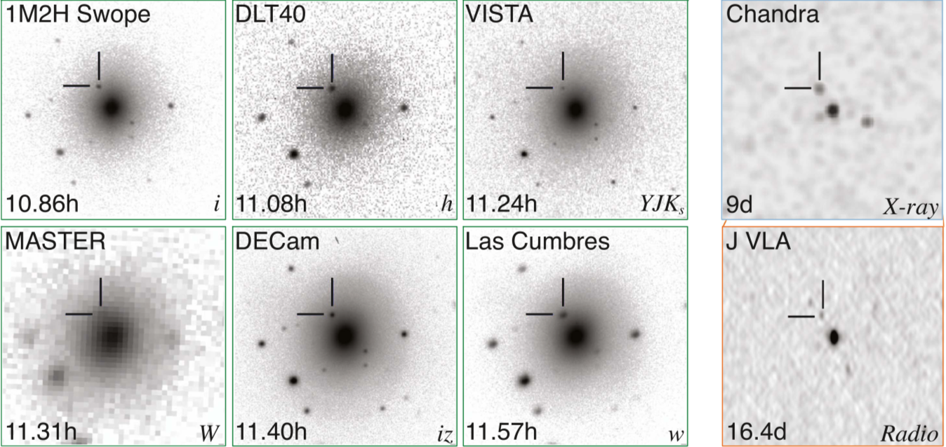
Multi-Wavelength Electromagnetic Observations of GW170817 (Many Collaborations, 2017)
Host galaxy is NGC 4993, z = 0.0097

Slide 10
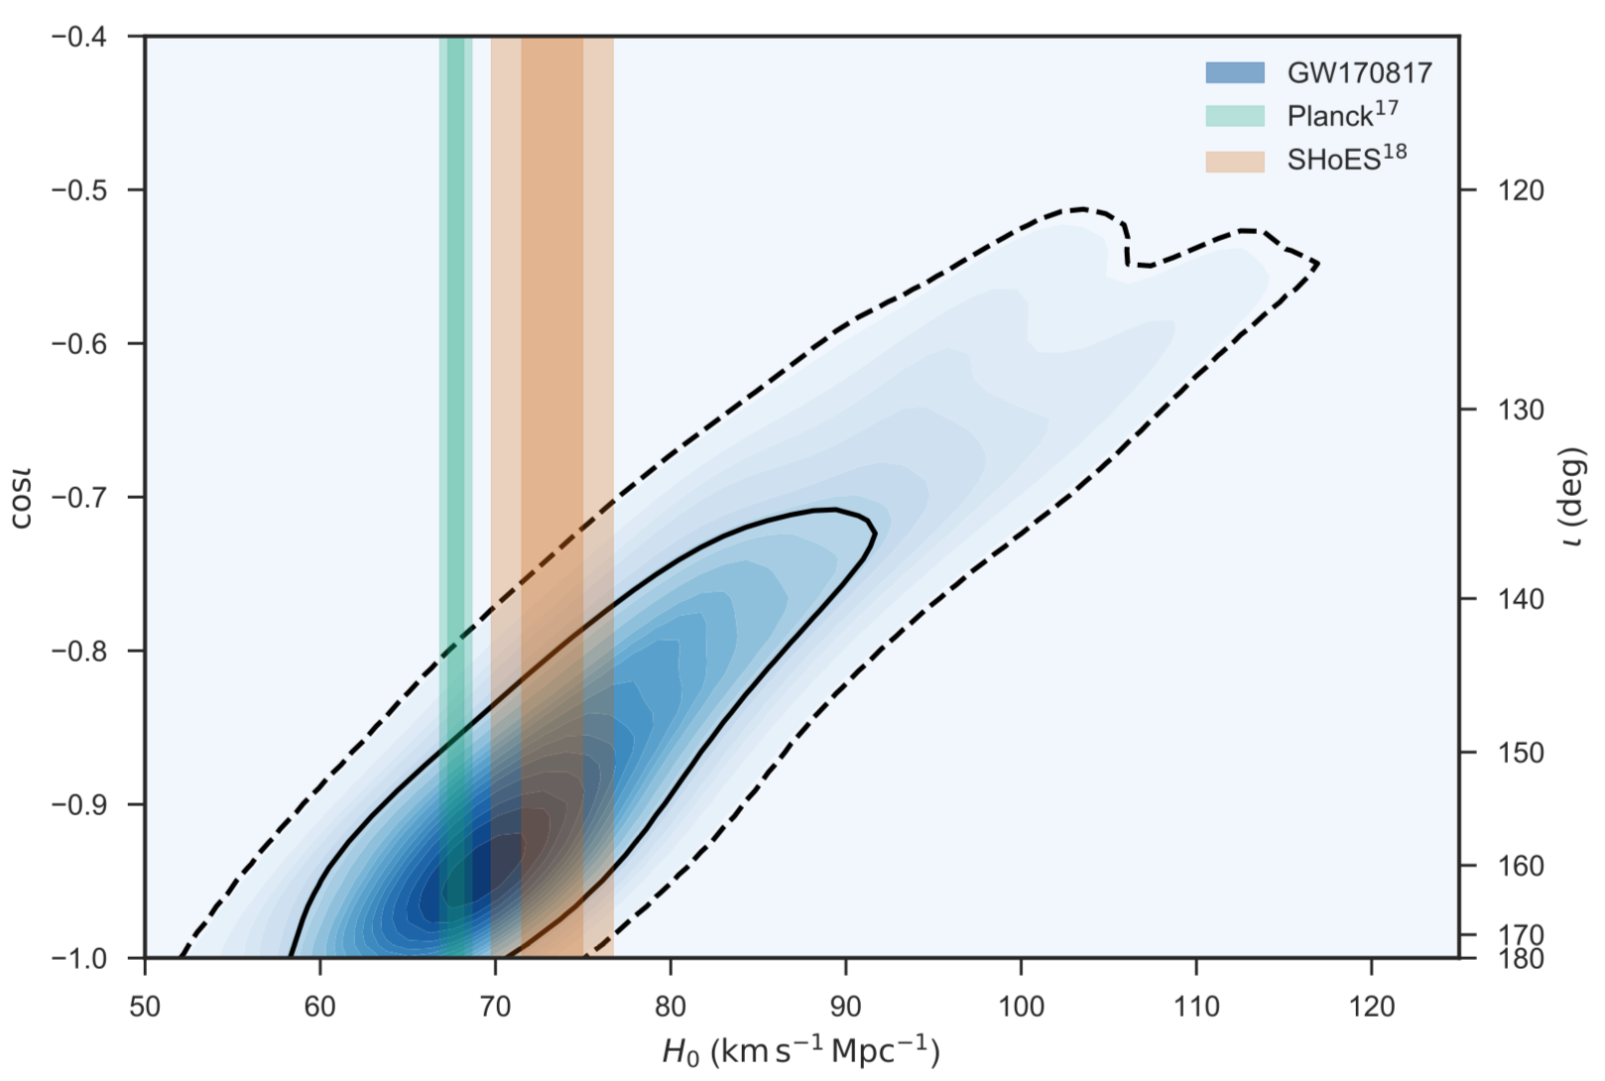
H₀ from 1 Gravitational Wave Source
Direct measurement
from Cepheids + SN Ia
Prediction from CMB + ΛCDM
Distance – inclination degeneracy

